Slide 1
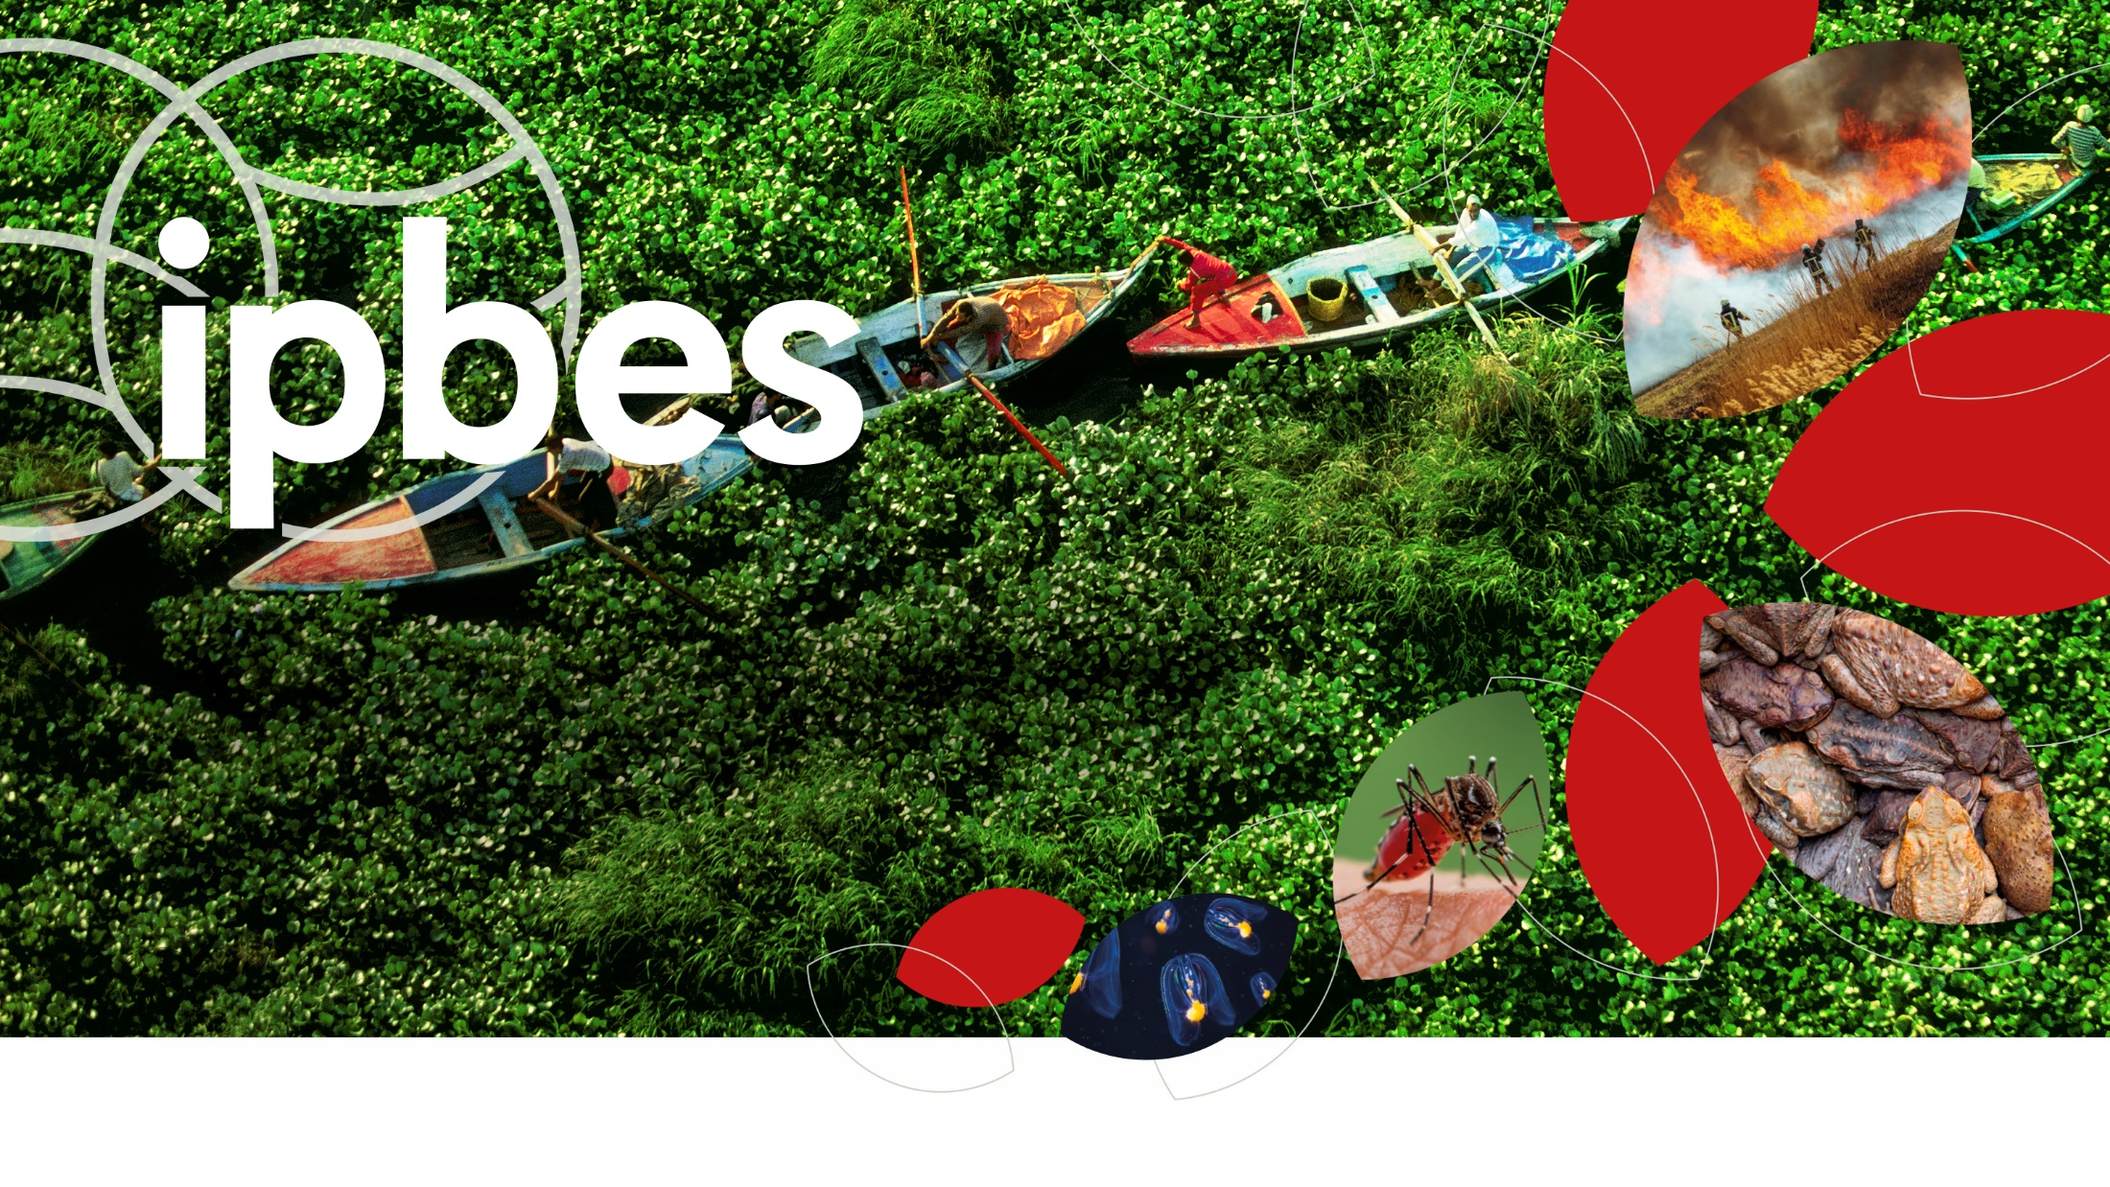
Assessment Report on Invasive
Alien Species and their Control
www.ipbes.net
The Intergovernmental Science-Policy Platform
on Biodiversity & Ecosystem Services
#InvasiveAlienSpecies Assessment

Slide 2

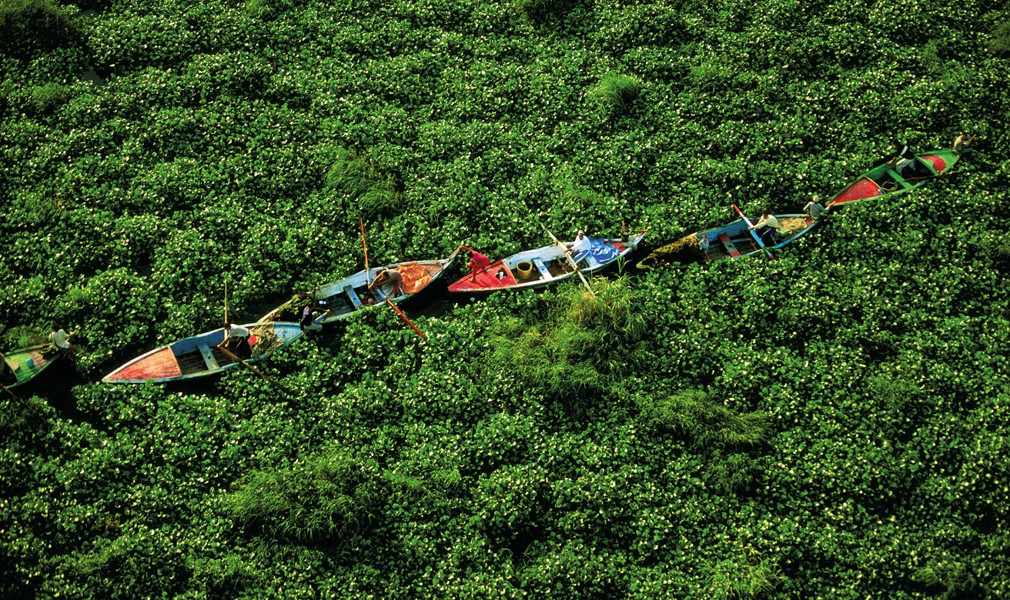
What are invasive alien species?
1.

Slide 3

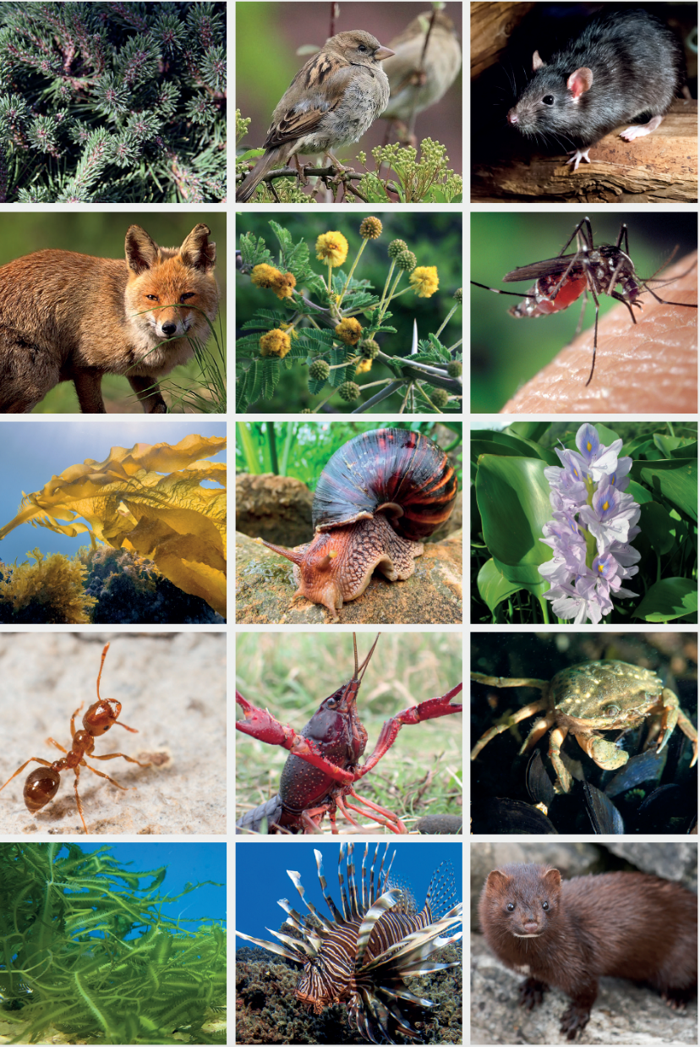
Invasive alien species are one of the 5 major drivers of biodiversity loss
Alien species are animals, plants, and other organisms that have been introduced by human activities to new regions
Invasive alien species are a subset of alien species, known to have established and spread with negative impacts on nature. Many invasive alien species also have impacts on people
#InvasiveAlienSpecies Assessment

Slide 4
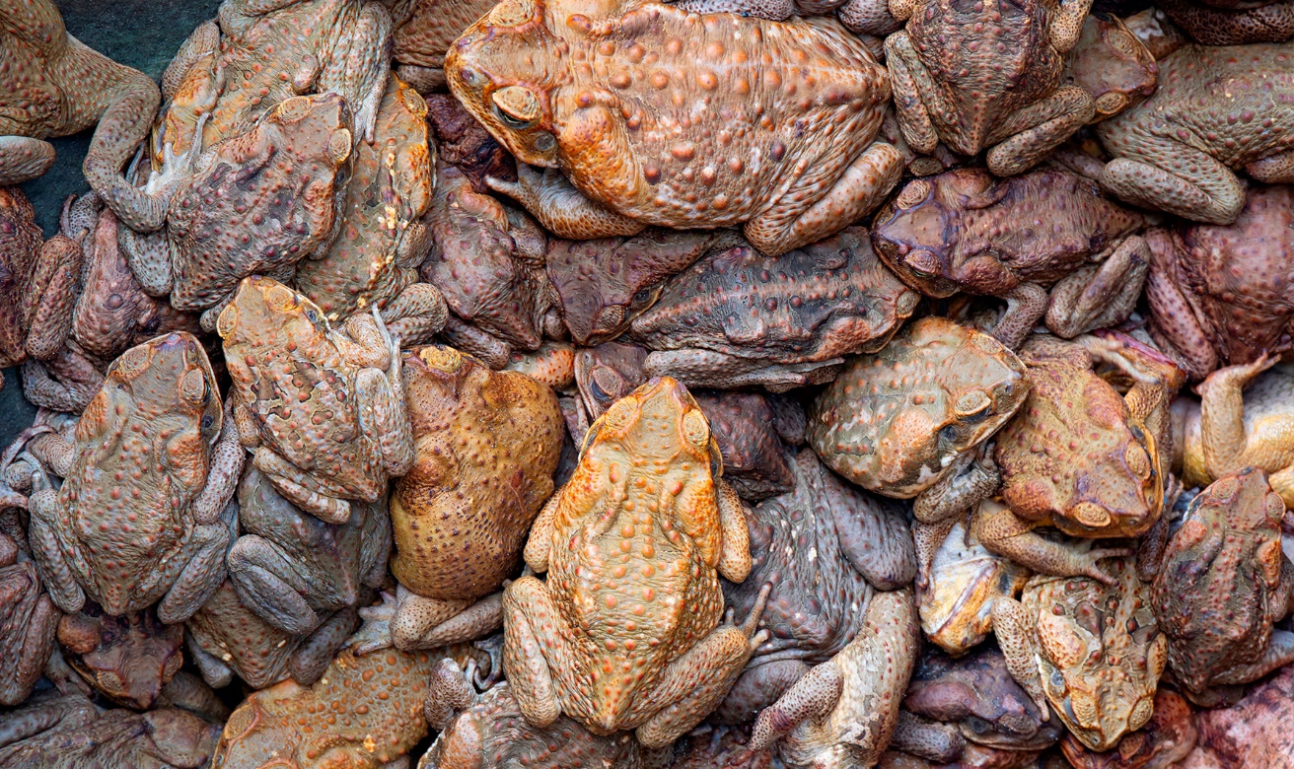
Findings of the report
2.

Slide 5
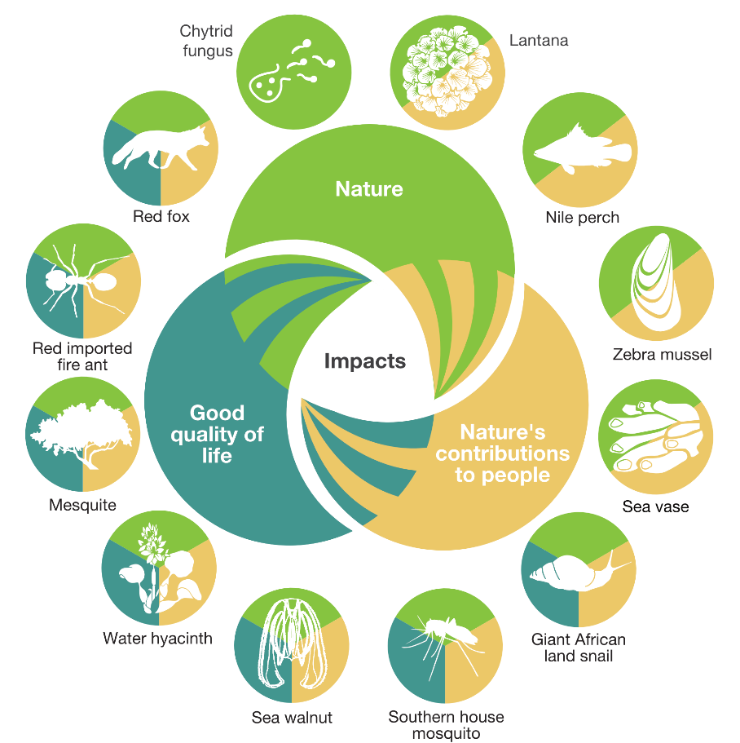
People and nature are threatened by invasive alien species in all regions of Earth
37,000 established alien species have been introduced by human activities worldwide
200 new alien species every year
3,500 invasive alien species, with negative impacts on nature, and also on people
More than 2,300 invasive alien species are found on lands of Indigenous Peoples across all regions of Earth
#InvasiveAlienSpecies Assessment

Slide 6

Current policies have been insufficient in managing biological invasions and preventing and controlling invasive alien species
Although most countries (80%) have targets for the management of biological invasions within their national biodiversity strategies and action plans
83% of countries do not have national legislation or regulations directed specifically toward the prevention and control of invasive alien species.
Nearly half of all countries (45%) do not invest in management of invasive alien species
#InvasiveAlienSpecies Assessment

Slide 7
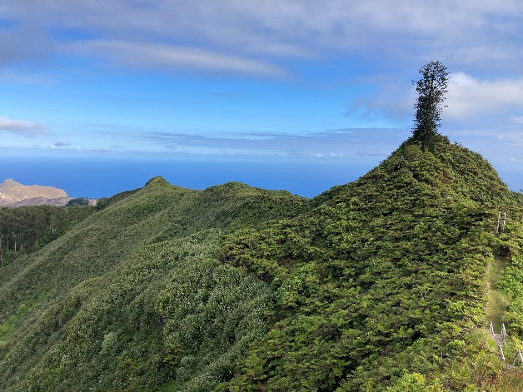
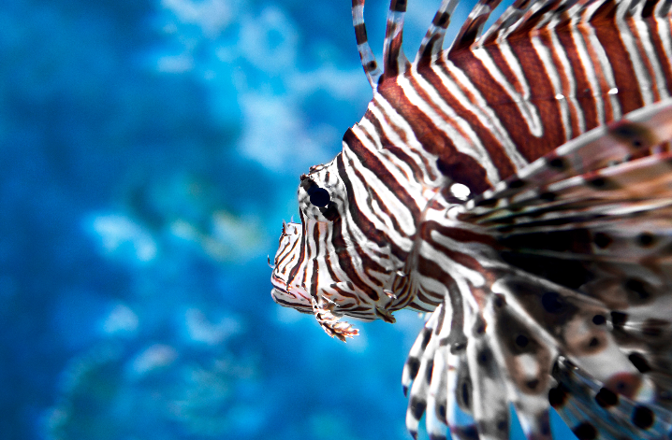
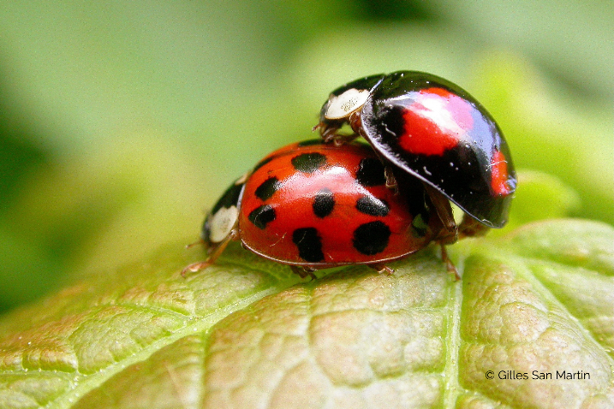
How do invasive alien species impact nature?
  Change ecosystems
  Predation and herbivory
  Compete with native species
#InvasiveAlienSpecies Assessment

Slide 8
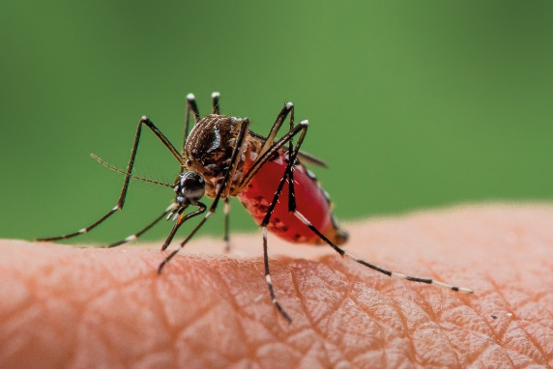
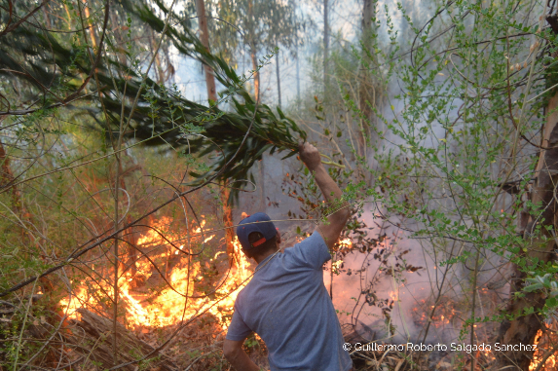
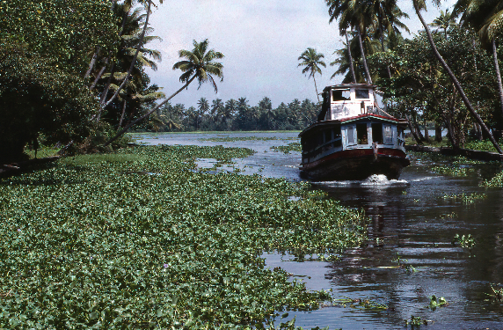
How do invasive alien species impact people?
Economies, food security, water security, human health and cultural identities are profoundly and negatively affected by invasive alien species
People with the greatest direct dependence on nature, including Indigenous Peoples and local communities, may be disproportionately affected by invasive alien species.
#InvasiveAlienSpecies Assessment

Slide 9
A few numbers on impacts
60%
>$423 billion
85%
80%
of global species extinctions have been caused, solely or alongside other drivers, by invasive alien species
is the estimated global annual costs of biological invasions in 2019.
of impacts on nature and good quality of life are negative
of impacts on nature’s contributions to people are negative
#InvasiveAlienSpecies Assessment

Slide 10
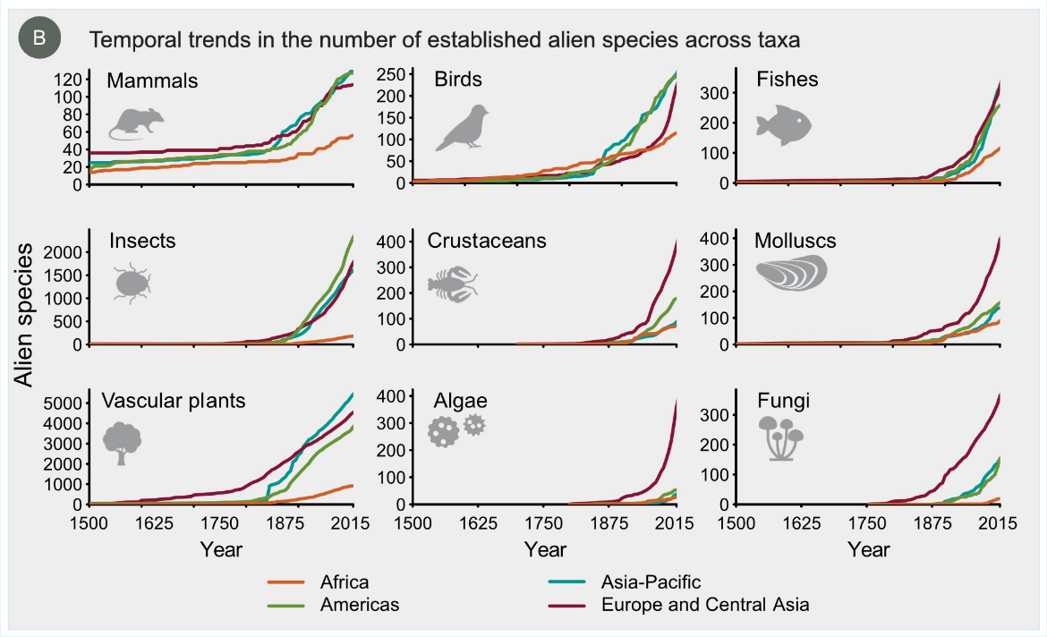
The threats from invasive alien species are increasing significantly in every region
#InvasiveAlienSpecies Assessment

Slide 11

People at the heart of the problem…
Many human activities facilitate the transport, introduction, establishment and spread of invasive alien species
If things remain unchanged, by 2050 the total number of alien species globally is expected to be about one-third higher than in 2005.
#InvasiveAlienSpecies Assessment

Slide 12
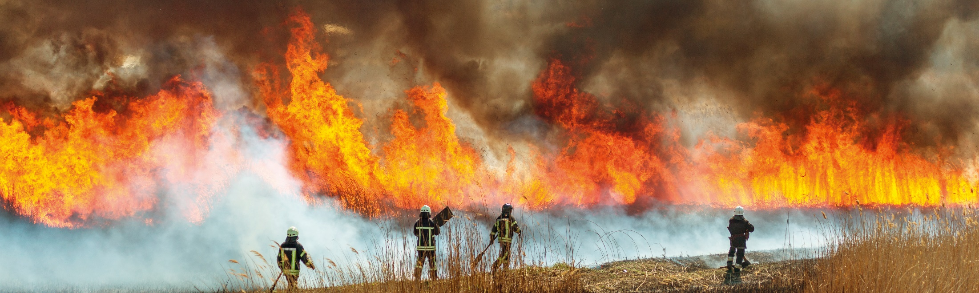
Invasive alien species and other drivers of change have complex interactions
Other drivers of change such demographic, economic, and land- and sea-use change are increasing and can amplify the threats and impacts of invasive alien species
Climate change will also be a major cause of future increases in the risk of invasive alien species
#InvasiveAlienSpecies Assessment

Slide 13
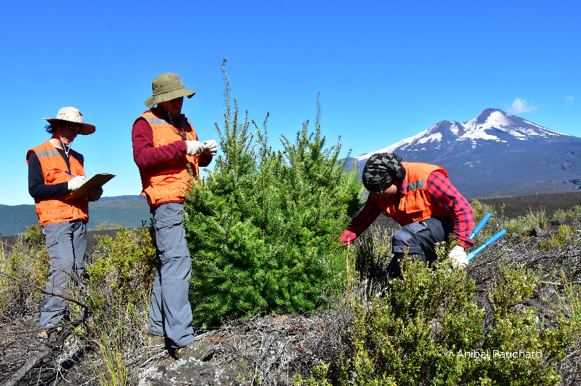
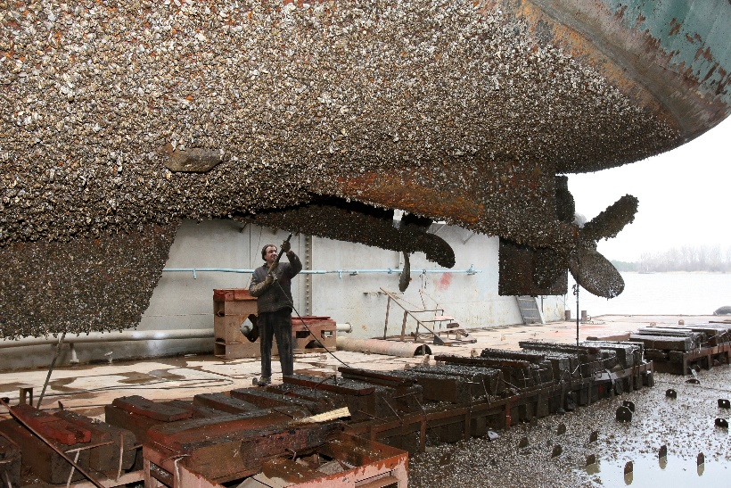
… People at the heart of the solution
Biological invasions and their adverse impacts can be prevented and mitigated through effective management
Prevention and preparedness are the most cost-effective options
Eradication, containment and control can also be effective options in some contexts
#InvasiveAlienSpecies Assessment

Slide 14
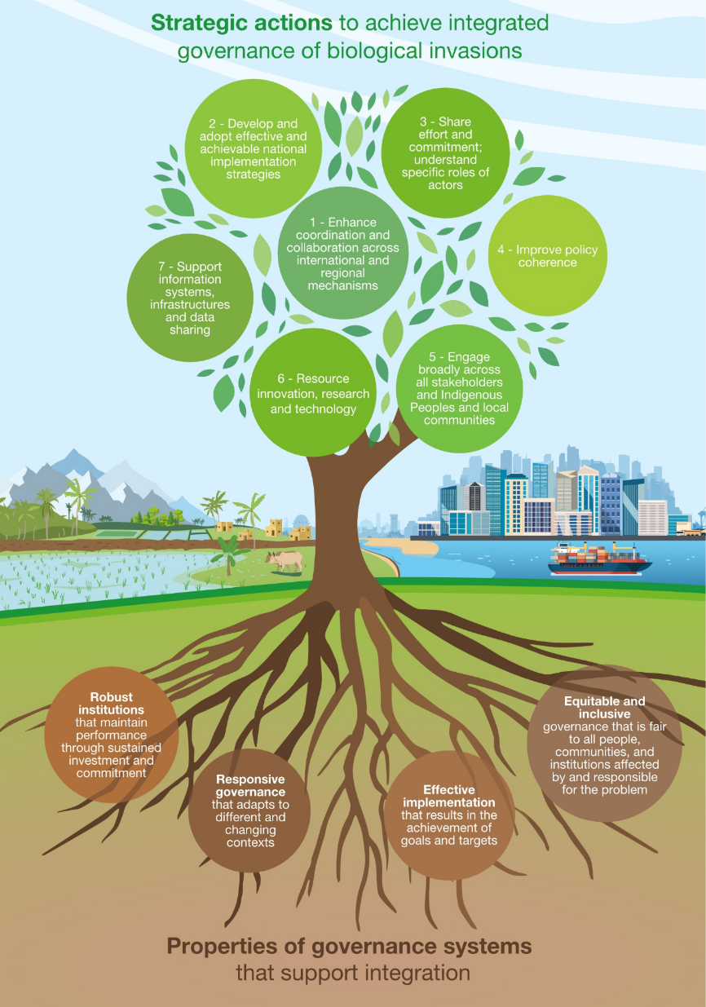
Ambitious progress in biological invasion management can be achieved with integrated governance
In December 2023, Governments have agreed to
“Eliminate, minimize, reduce and or mitigate the impacts of invasive alien species on biodiversity and ecosystem services by identifying and managing pathways of the introduction of alien species, preventing the introduction and establishment of priority invasive alien species, reducing the rates of introduction and establishment of other known or potential invasive alien species by at least 50 per cent by 2030, and eradicating or controlling invasive alien species, especially in priority sites, such as islands” Kunming-Montreal Global Biodiversity Framework, Target 6.
#InvasiveAlienSpecies Assessment

Slide 15
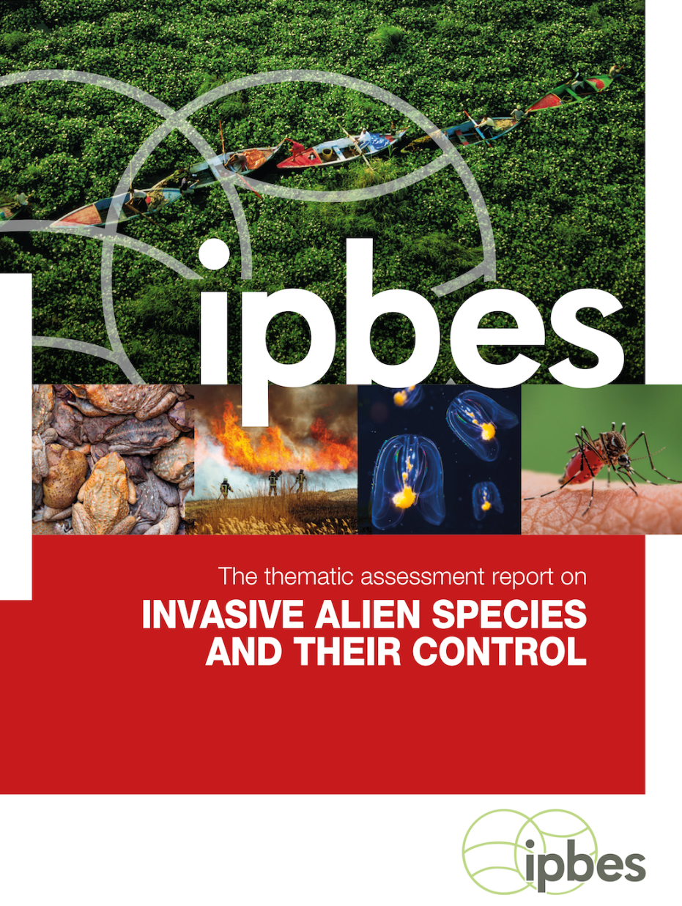
There is compelling evidence for immediate and sustained action
With sufficient resources and long-term commitment, preventing and controlling invasive alien species are attainable goals that will yield significant long-term benefits for people and nature.
#InvasiveAlienSpecies Assessment

Slide 16
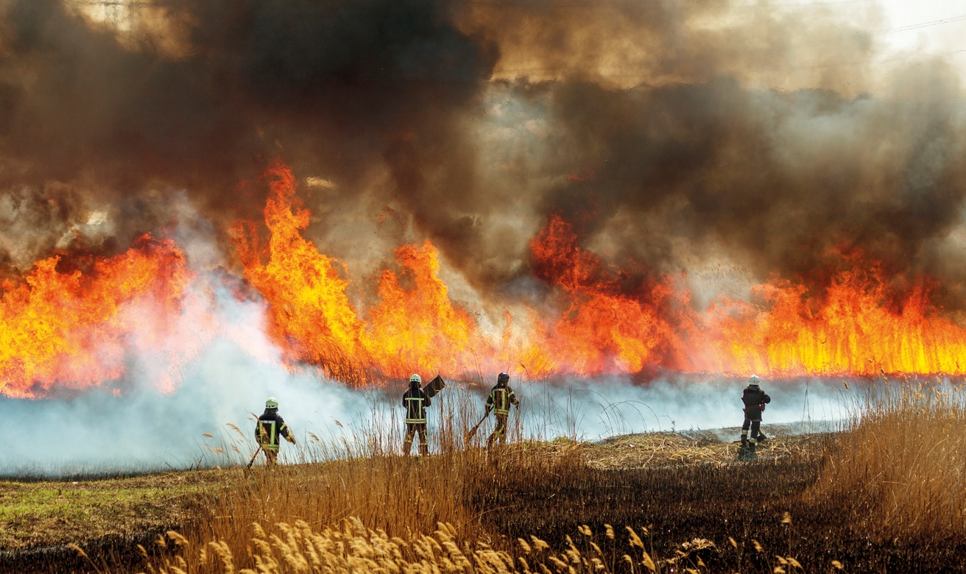
Expected impacts of the Report
3.

Slide 17
The invasive alien species Assessment is the first comprehensive global report on invasive alien species and their control
It provides the best-available evidence, critical analysis and options for governments, civil society, Indigenous Peoples and local communities, the private sector and all those seeking to address the issue of biological invasions
#InvasiveAlienSpecies Assessment

Slide 18

The findings of the invasive alien species assessment are expected to contribute to achieving international targets on biological invasions:
- Target 6 of the Kunming-Montreal Global Biodiversity Framework
- Support implementation of the Sustainable Development Goals of the 2030 Agenda for Sustainable Development, especially Goal 15
Photo by IISD/ENB
#InvasiveAlienSpecies Assessment

Slide 19
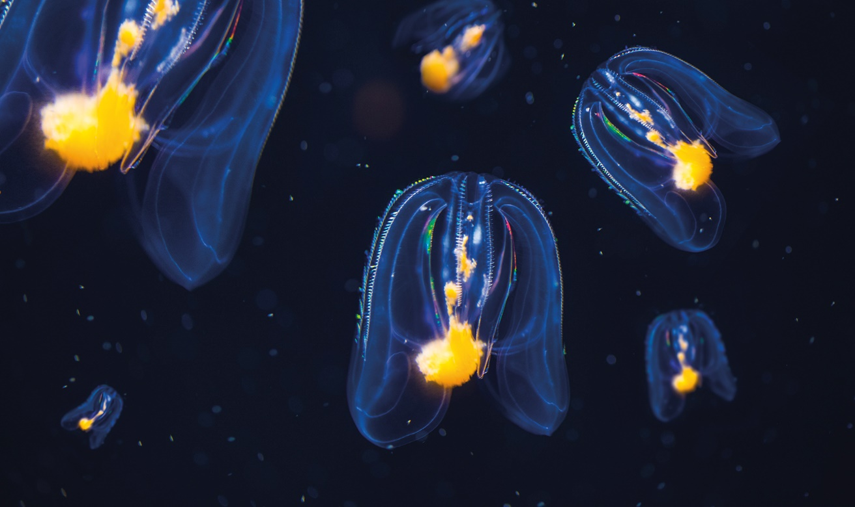
Assessment process
4.

Slide 20
Developed over 4 years
3 Authors meetings (Tsukuba, online & Aarhus)
2 External reviews
1 Additional review by governments
Produced by a multidisciplinary team of 86 experts and many contributing authors
Over 13,000 documents reviewed in depth
Various values and knowledge systems considered, drawing on scientific and grey literature, and information from indigenous and local knowledge
Engagement with Indigenous and local knowledge
3 dialogue workshops (Montreal and online),
a call for contributions, and
collaboration with ILK experts and holders within the expert team and as contributing authors
#InvasiveAlienSpecies Assessment

Slide 21
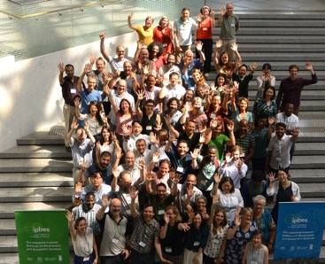
Produced by a multidisciplinary team of 86 experts and many contributing authors
86 nominated experts from 47 countries, encompassing all regions and many disciplines
About 200 contributing authors
Supported by a management committee
Technical support unit based in Japan (Institute for Global Environmental Strategies, IGES)
#InvasiveAlienSpecies Assessment

Slide 22

Thank you!
¡Gracias!
Merci!
#InvasiveAlienSpecies Assessment

Slide 23
